Slide 1
European Agricultural Fund for Rural Development (EAFRD) Latvian Rural Development Program 2014-2020 Sub-Action "Inter-territorial and Transnational Cooperation"
Project
Development of Cycling Tourism in Eastern Latvia by Joining the International Cycling Route Network "EuroVelo11"
Project Nr.19-00-A019.332-000002

Slide 2
“EuroVelo11”
Aim of the Project: To promote the development of cycling tourism in the Eastern Latvia region by labeling the cycling route “EuroVelo11”, thus promoting Eastern Latvia as a European cycling tourism destination, contributing to climate change mitigation, traveling green and promoting business development in the areas along the cycling route.

Slide 3
„EuroVelo11”
Total funding of the project 99 850,00 EUR
The project runs until September 30, 2021

Slide 4
Project partners
«Ludza District Partnership» (leading partner)
Association "Daugavpils and Ilukste Municipality's Partnership "Kaimiņi""
Association "Balvi District Partnership"
Association "Rezekne District Community Partnership"
Association "Kraslava District Partnership"
Association "SATEKA"
Association "Preiļi District Partnership"

Slide 5
Project activities
Project Opening Conference,
Seminar cycle I,
Cycling route marking,
Map of Eastern Latvia cycling routes,
Seminar cycle II,
Equipping of stopping points for cycling routes,
Cycling marathon,
Closing conference,
Strategy development.

Slide 6
Expected results of the project
Developed Eastern Latvia Cycling Tourism Development Strategy including Action Plan with concrete steps to be taken in the future;
Marked cycling route EuroVelo 11, equipped with information boards and bicycle stands;
Developed and printed maps of Latgale cycling routes;
Organized conferences dedicated to the development and improvement of tourism in Eastern Latvia, attracting entrepreneurs located in the area of route.
Organized cycling marathon in which all Partners and their representatives participate, thus promoting cycling tourism.

Slide 7
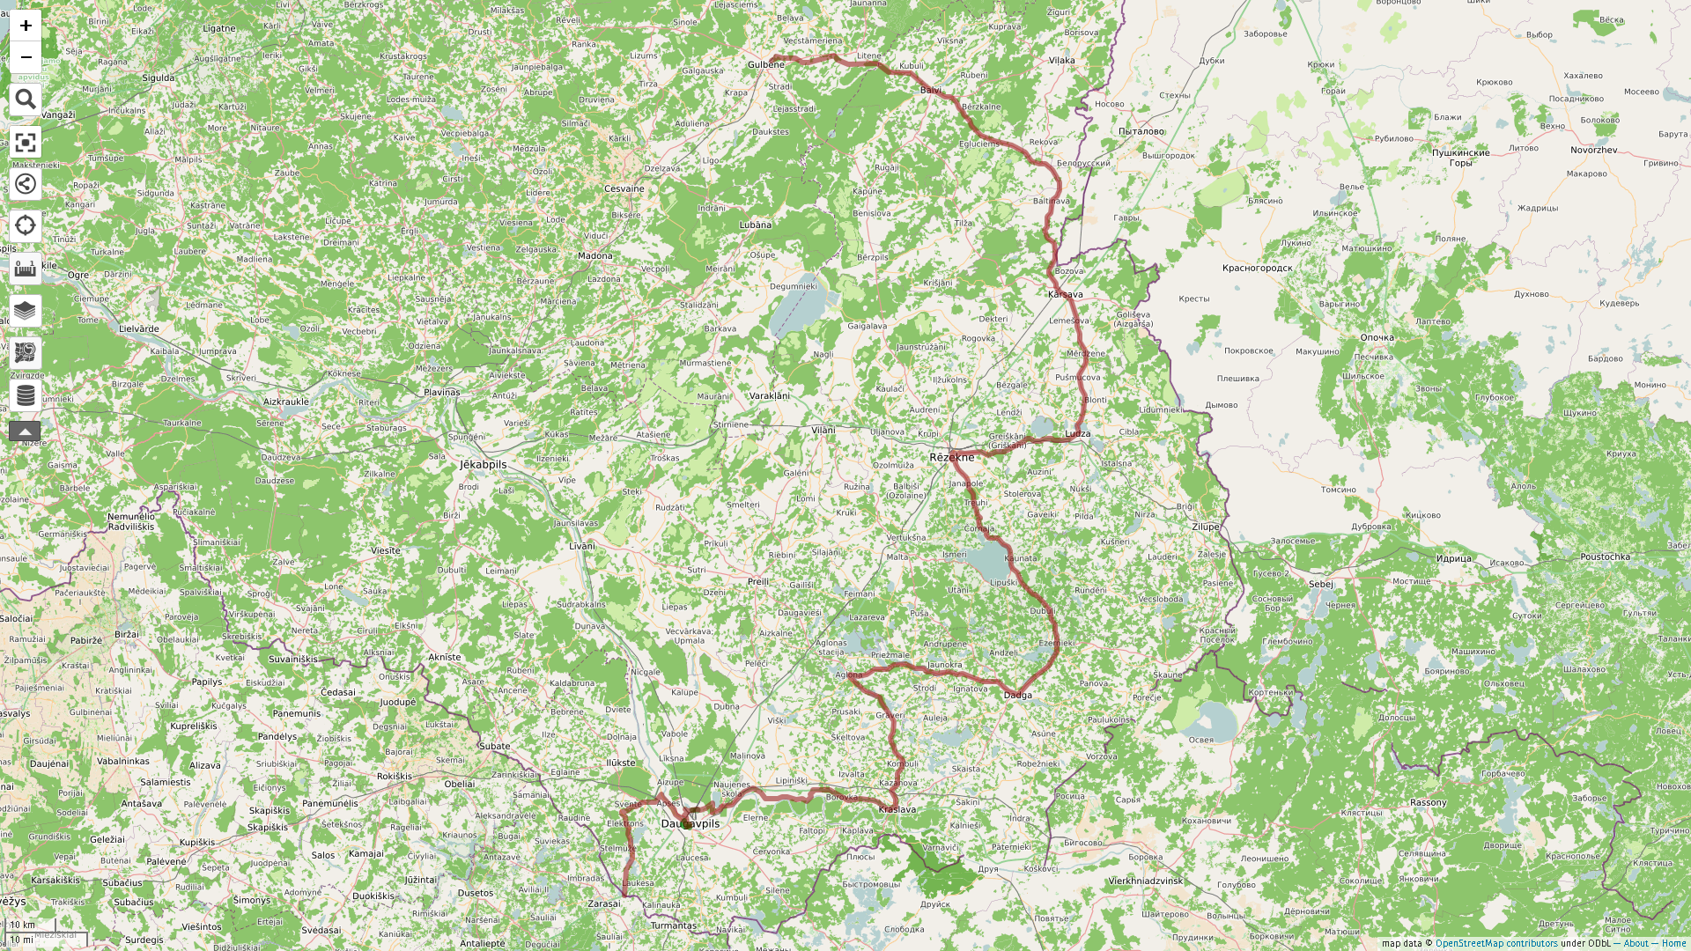
Maršruts: " EuroVelo 11" http://u.osmfr.org/m/287428/

Slide 8
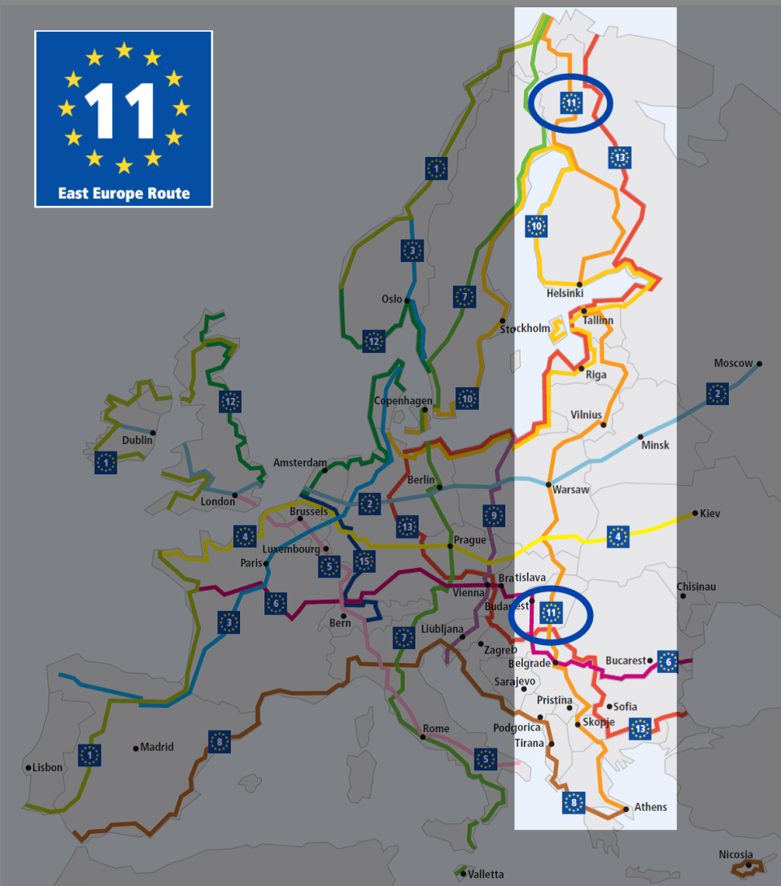
„EuroVelo11”

Slide 9
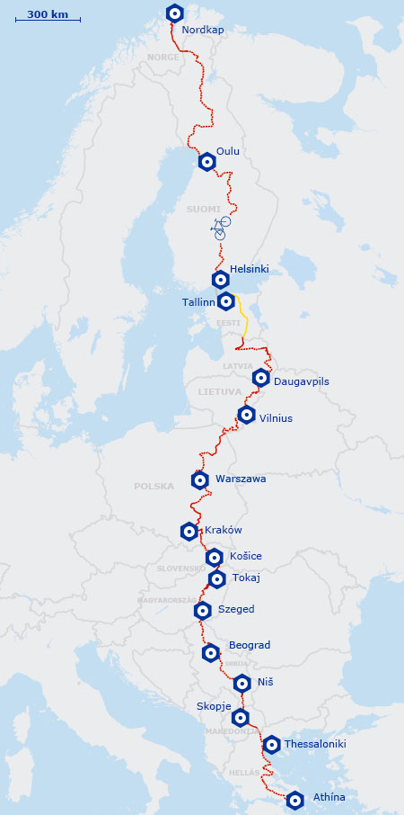
„EuroVelo11”

